Slide 1
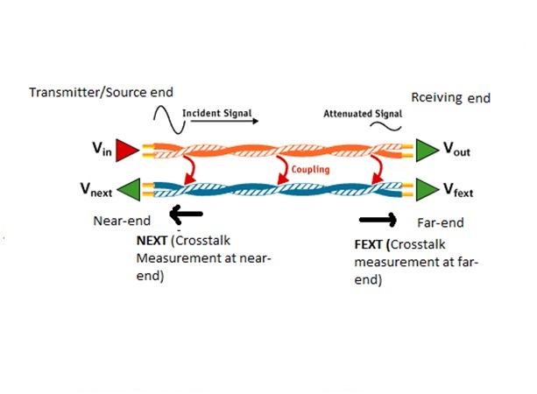
The Induced Leak — Faraday's Law as a Security Threat
How electromagnetic crosstalk leaks binary data. A concise technical walkthrough : from moving electrons to recoverable voltage pulses, and practical mitigations.

Slide 2
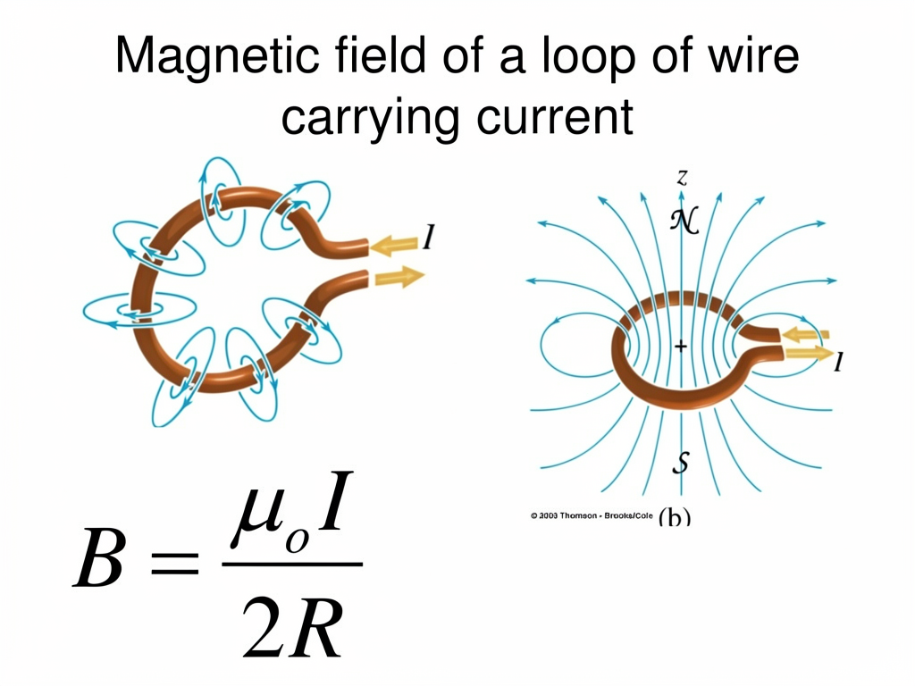
Current & Its Magnetic Field
Electric current is a flow of charges. Any moving charge produces a magnetic field encircling the conductor (Ampère's Law). Field strength scales with current and decays with radial distance.
B = μ₀ I / (2π r)
Design takeaway
Magnetic flux density B around a long straight wire — inverse proportion to distance r.
Higher currents and closer proximities increase off‑wire magnetic field intensity and leakage risk.

Slide 3
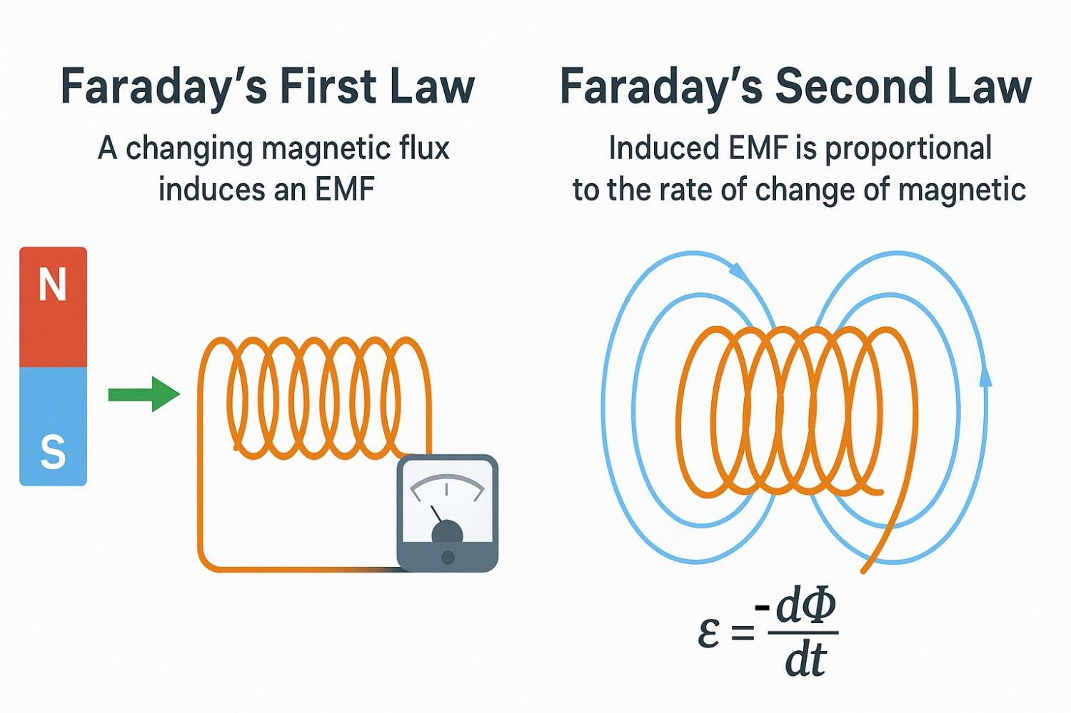
Magnetic Flux & Faraday's Law
Magnetic flux Φ quantifies how much magnetic field passes through a loop: Φ = B · A · cosθ. Faraday's Law relates changing flux to an induced voltage:
Faraday
Implication
e = −dΦ/dt — a voltage appears only when flux changes over time.
Static current produces steady Φ → no induced e. Rapid changes in current (edges) create dΦ/dt → measurable pulses.

Slide 4
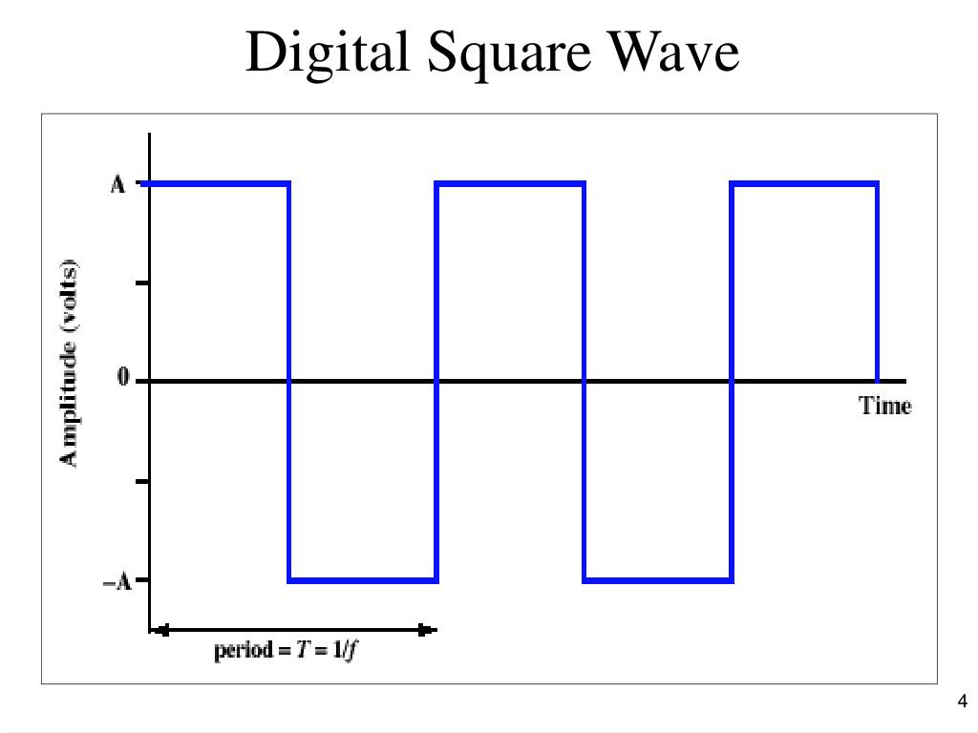
Digital Signals & Edges
Digital logic toggles between voltage states; transitions (edges) concentrate spectral energy and dI/dt. Edge polarity maps to induced pulse sign:
Rising edge (0 → 1)
Fast current increase → positive dΦ/dt → positive induced pulse on a nearby loop.
Falling edge (1 → 0)
Fast current decrease → negative dΦ/dt → negative induced pulse.

Slide 5

The Attack: Crosstalk
Crosstalk, often viewed as an electrical engineering nuisance, transforms into a potent security vulnerability when sensitive digital data is involved. It describes the unwanted transfer of energy or signal from one circuit or transmission path to another nearby.
In our context, the rapidly changing current (dI/dt) on an active data line, generated by digital signal edges, creates a transient magnetic field. This field then couples with an adjacent, unsuspecting line, which acts as a passive "aggressor" or "receiver" of this unintended signal.
Induced Voltage
Data Replication
Stealthy Eavesdropping
The changing magnetic flux (dΦ/dt) from the active data line, as predicted by Faraday's Law, induces a parasitic voltage pulse on the adjacent aggressor line. This pulse is directly proportional to the rate of change of the magnetic flux.
These induced voltage pulses faithfully mirror the timing and polarity of the original digital transitions. This effectively replicates the binary data onto a nearby line that should ideally be silent or carrying unrelated, non-sensitive information.
This electromagnetic phenomenon facilitates non-invasive eavesdropping. Attackers do not require direct electrical contact; mere physical proximity between the data line and their sensing equipment is often sufficient to passively "listen" to the electromagnetic emanations and reconstruct the digital signal.

Slide 6
The Math Behind Leakage:
The induced voltage, the very essence of information leakage, is dictated by a critical confluence of factors. This combined leakage equation encapsulates how the change in current in one cable creates a measurable voltage in an adjacent, unshielded conductor:
This elegant equation reveals the direct and inverse relationships that govern the susceptibility to crosstalk. Understanding each variable is paramount for effective mitigation.
1
2
3
dI/dt: Signal Speed
r: Distance
A ⋅ cos(θ): Coupling Area
The faster the rate of change of current, the stronger the induced voltage. High-frequency digital signals with sharp edges are inherently riskier.
The induced voltage is inversely proportional to the distance between the source and victim cables. Closer proximity significantly amplifies leakage.
This term accounts for the effective area and orientation of magnetic field lines passing through the victim's loop. Parallel routing maximises this coupling.

Slide 7

Real-World Examples & Why It's Dangerous
Electromagnetic leakage is a proven attack vector with concrete precedents. It threatens confidentiality across hardware stacks:
TEMPEST-style interceptions: remote recovery of display/keyboard signals.
PCB parallel traces and multi‑layer routing create tightly coupled paths.
Ribbon and server rack cables running side-by-side provide long coupling length ℓ.
Passive, forensics‑free capture makes mitigation largely architectural and physical.

Slide 8
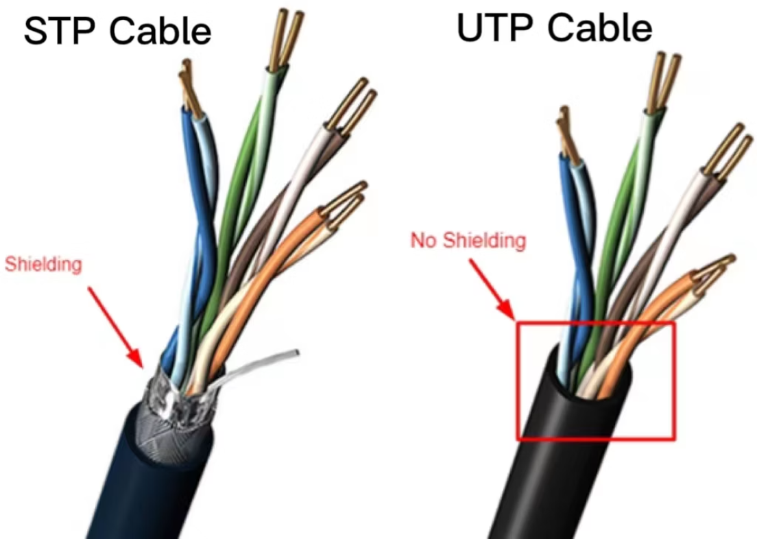
Countermeasures — Practical Defenses
Twisted pairs
Shielding
Opposing currents cancel loop area → dramatically reduces captured flux.
Magnetic shields (mu-metal, high‑permeability layers) and grounded enclosures limit field escape; use where space permits.
Distance & routing
Signal shaping
Separate sensitive and untrusted runs; minimize parallel routing length ℓ; use orthogonal crossings where feasible.
Controlled slew rates or intentionally randomized timing reduce the correlation between transitions and payload bits.

Slide 9
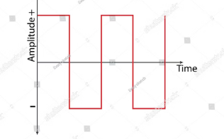
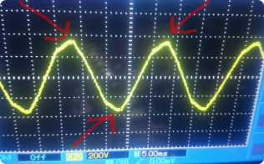
Demo: The Pulse Waveform
A stacked waveform view clearly illustrates the induced leakage mechanism and how it can be exploited:
Observation
Forensic Reconstruction
Pulse Characteristics
Each rapid voltage transition (edge) in the source signal produces a time-aligned, transient voltage spike on a nearby conductor. The polarity of these induced spikes directly encodes the direction of the original bit transition (e.g., 0→1 or 1→0).
The amplitude of the induced pulse is proportional to the rate of change of current () in the source line and the mutual inductance between the conductors. Faster signal edges and closer proximity yield stronger, more easily detectable leakage signals.
By precisely timestamping and identifying the polarity of each induced spike, an attacker can reconstruct the original binary bitstream. This allows for full recovery of data, framing, and even protocol timing without direct physical access to the target wire.

Slide 10
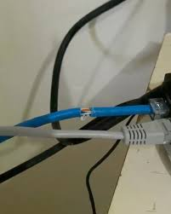

Summary — Physics is the Vulnerability
Chain of leakage: I → B → Φ → e. Every fast bit transition can create an induced electromagnetic pulse on nearby conductors. Mutual inductance M couples cables; an attacker with access to Cable B can recover Cable A's data passively. Mitigation requires physical and signal‑level controls — twisted pairs, shielding, spacing, and edge control.
Action item: review cabling topology and signal slew rates for high‑risk systems; prioritise physical isolation and shielding for classified links.

